Slide 1


POWER BI CAPSTONE PROJECT
PRIYANKA-S10205

Slide 2


Introduction
Exploring Coffee Quality Data with Power BI
The quality of coffee is influenced by several factors, including origin, processing methods, and sensory attributes. Coffee quality analysis enhances understanding of coffee production, consumption patterns and provides insights for producers, traders, and consumers aiming for premium coffee standards.

Slide 3
Objectives
To explore the relationship between sensory attributes and overall coffee quality.
To assess the impact of processing methods and origin regions on coffee quality.
To identify trends in defect severity and its effect on coffee quality.
To provide actionable insights for stakeholders in the coffee industry.

Slide 4
Dataset Overview
Source:
This dataset is from Coffee Quality Institute (CQI) which is a non-profit organization that works to improve the quality and value of coffee worldwide. It was founded in 1996 and has its headquarters in California, USA.
Scope:
Focuses on sensory attributes, processing methods, origin regions, and defect occurrences.
Purpose:
To evaluate coffee quality through quantitative and qualitative measures.

Slide 5
Key Variables
Sensory Attributes: Aroma, flavor, acidity, body, aftertaste, Balance, Uniformity, Clean Cup, Sweetness.
Quality Metrics: Total Cup Points, Overall.
Processing Methods: Washed, Natural, Honey, Semi Washed, Anaerobico 1000h, Double Anaerobico Washed, etc.
Regional Data: Country or region of origin.
Defect Measures: Category One Defects, Category Two Defects.

Slide 6
Methodology
Data Collection
Data Preprocessing
Exploratory Data Analysis
Visualization
Insights and Reporting
Tools Used
Microsoft Power BI
Microsoft Excel

Slide 7
Data Preprocessing
Replaced missing values with Unknown.
Bag Weight - Extracted kg and converted to whole number.
In-Country Partner - Replaced Chinese words to English.
Grading Date - Converted to date format.
Expiration - Converted to date format.

Slide 8
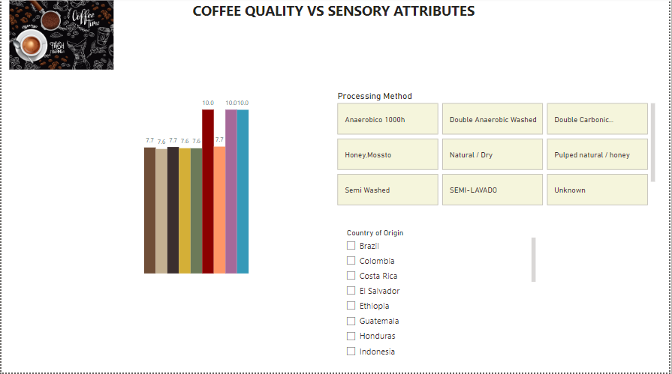
Reports

Slide 9
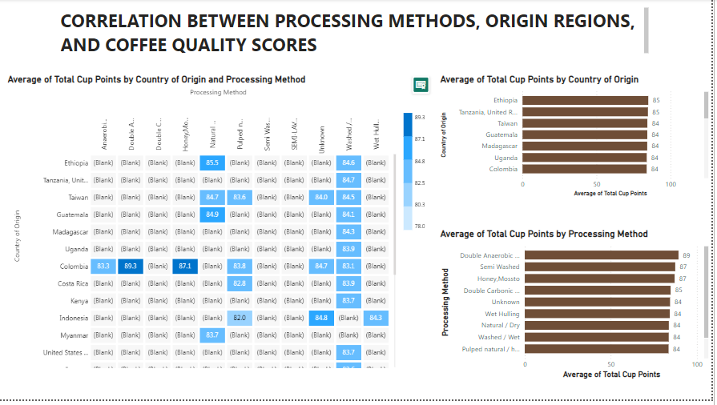
Reports

Slide 10
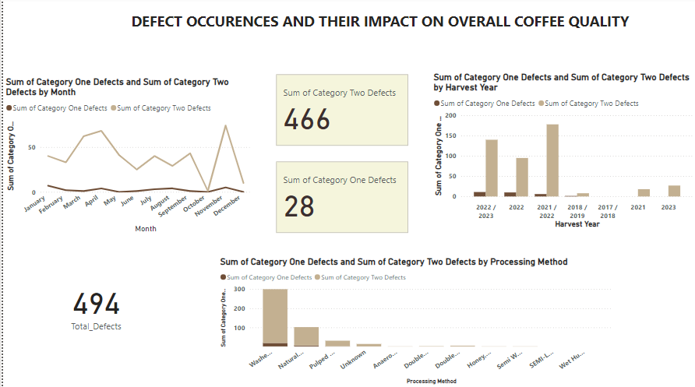
Reports

Slide 11
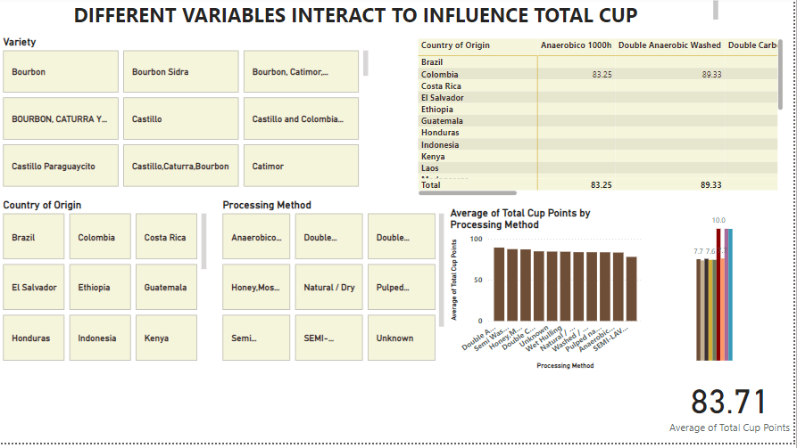
Reports

Slide 12
Insights
Key Findings:
Sweetness, Uniformity, Clean Cup scores show the highest correlation with Total Cup Points.
"Double Anaerobic Washed”, “Honey, Mossto”, "Semi Washed" processing methods has the highest average total cup points with respect to country of origin.
Ethiopia country has the highest average total cup points and Double Anaerobic Washed processing method has the highest average total cup points.
The reports shows 28 instances of category one defects and 466 instances of category two defects.
Washed/Wet processed beans has more defects. November, April and March graded beans has more defects. 2021/2022 and 2022/2023 harvest year has more defects.
Actionable Advice:
Focus on optimizing sensory attributes during cupping evaluations.
Educate farmers on the benefits and challenges of different methods to align with market demands.
Implement a holistic approach to enhance both sensory attributes and defect reduction.

Slide 13

THANK YOU

